Slide 1
Threshold Concepts Year 5 The Building Blocks for Learning
Spirituality: Mirrors
Reflecting on the things greater than ourselves

Slide 2
English Threshold Concepts KS2
Writing Targets
1 | Write legibly Capital letters: I, proper nouns & sentences Full stops Question marks Join clauses using ‘and’
2 | Most sentences make sense Exclamation marks Subordinating and coordinating conjunctions
3 | Apostrophes for contracted words Commas (for lists) Paragraphs
4 | Inverted commas Correct use of tense Non-narrative: structure e.g. headings & subheadings Narrative: describe settings and characters
5 | Commas (fronted adverbials) Apostrophes for possession A range of cohesive devices: conjunctions, adverbials, pronouns & synonyms Select vocabulary: e.g. ‘Show don’t Tell’ in narratives; technical words in non-narrative Begin to match level of formality to audience
6 | Legible, cursive handwriting Semicolons, colons, hyphens, dashes, commas for clarity (relative clauses, parenthesis) Dialogue, Action, Description DAD (correctly punctuated) A range of sentence structures to match audience and purpose (incl. passive) Narrative: create atmosphere
Greater Depth | The ‘voice’ of an author Precise use of punctuation to enhance meaning Control the level of formality Non-narrative: effectively organise information and ideas Create an effect (e.g. tension)
English Threshold Concepts
Speaking
Speak clearly and confidently Communicate effectively with vocal and body language
Reading
Read for pleasure Read fluently Extract ideas and information from a text Identify the meaning of words in context Make inferences supported by evidence Understand writers’ techniques and viewpoints Understand the audience and purpose of writing
Writing
Use neat, cursive script to present with pride Use a range of punctuation to support meaning Use a range of sentence and text structures to support meaning Spell correctly to communicate clearly Use ambitious vocabulary Use subject vocabulary

Slide 3
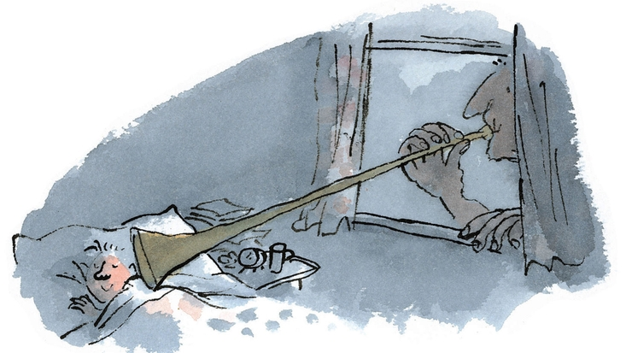
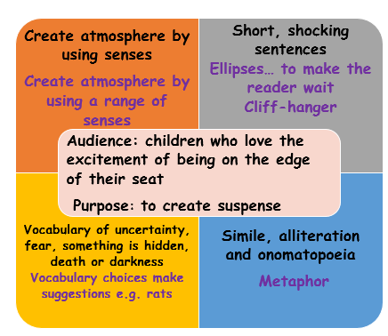
BFG – The Dream Giver: English Threshold Concepts
Spirituality: Can stories help us find meaning and purpose in the things we value?
Narrative-Suspense
Reading
Read fluently
Identify the meaning of words in context
Understand writers’ techniques and viewpoints
Can I identify writers’ techniques? Suspense
Senses: see, hear, touch, smell, taste
Short sentences
Ellipses
Words which show fear, uncertainty, shadows, something hidden
Simile, metaphor
Further Vocabulary
phrase, effect
Deeper Thinking: Read The BFG to explore the different values of the characters.

Slide 4
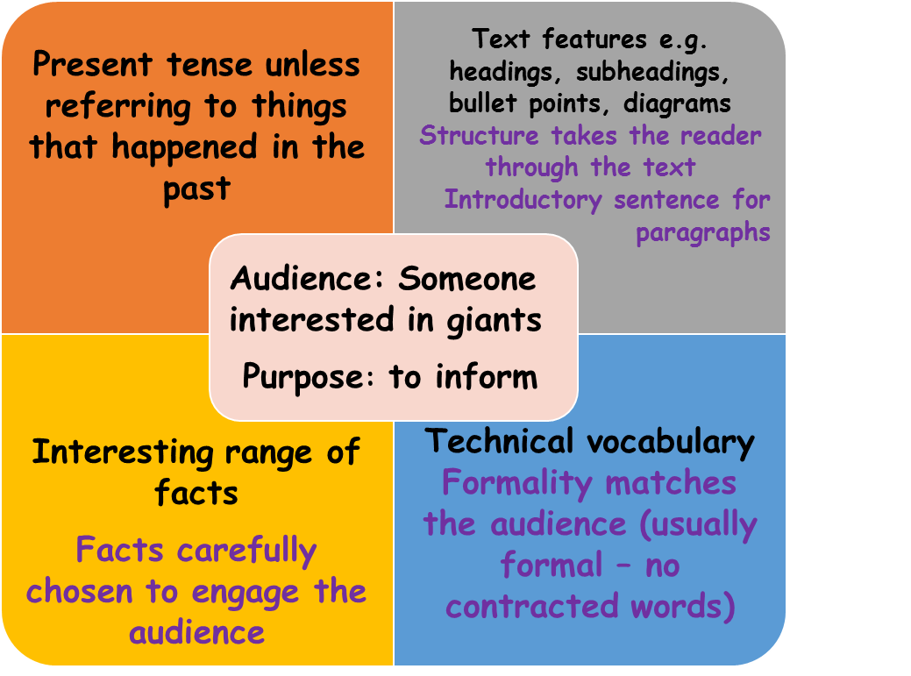
BFG - GIANTS: English Threshold Concepts
Spirituality: Can knowledge help us to flourish?
Non-Chronological report
Reading
Read fluently
Identify the meaning of words in context
Extract information and ideas from a text
Make inferences supported by evidence
Understand writers’ techniques and viewpoints
Can I identify writers’ techniques? Non-chronological report
Headings and sub-headings
Introduction
Sections
Introductory sentences for each paragraph
Tables, pictures, diagrams, maps etc
Technical vocabulary
Formal or informal?
Further Vocabulary
Skim, scan
Deeper Thinking: Read The BFG find further information about Giants

Slide 5
BFG - Dreams and Dream Jars: English Threshold Concepts
Spirituality: Can becoming aware of the motives of others
give us peace of mind and inner freedom?
Reading
Read fluently
Identify the meaning of words in context
Extract information and ideas from a text
Make inferences supported by evidence
Understand writers’ techniques and viewpoints
Persuasion
Can I identify writers’ techniques? Persuasion
Catchy Title
Opinion or personal account
Exaggeration
Rhetorical questions
Alliteration
Slogans
Further Vocabulary
Skim, scan, inference, opinion
Deeper Thinking: Read The BFG find further information about Dream Jars.

Slide 6
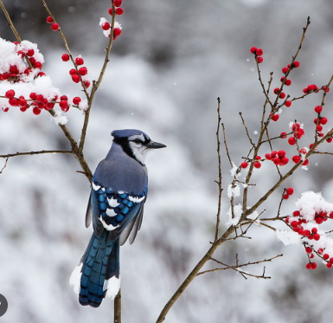
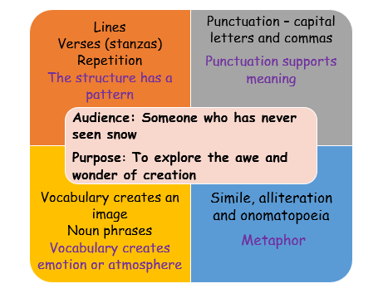
Snow: English Threshold Concepts
Spirituality: Can poetry help us to connect with the awe and wonder of creation?
Poetry Writing
Reading
Read fluently
Identify the meaning of words in context
Extract information and ideas from a text
Make inferences supported by evidence
Identify writers’ techniques - Poetry
Senses: Touch, Smell, Taste, Sight, Hearing
Figurative language: Alliteration, Onomatopoeia, Repetition, Simile, Metaphor
Structure: Verse, Rhyme
Punctuation
Further Vocabulary
inference, context, feeling, impression, poetry/poem, verse, image/imagery expanded noun phrase – determiner, adjective, noun
Deeper Thinking: Read some more nature poems.
How do they help you to connect with the awe and wonder of creation?

Slide 7
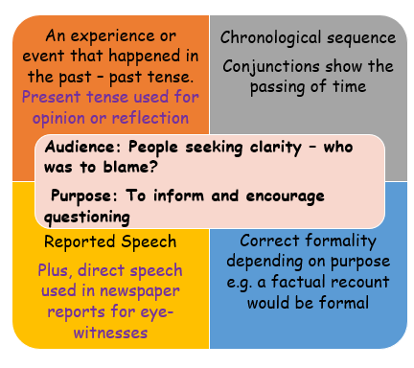
The True Story of the Three Little Pigs: English Threshold Concepts
Spirituality: Can news reports help us explore the reasons for different opinions?
Newspaper Report Writing
Reading
Read fluently
Identify the meaning of words in context
Extract information and ideas from a text
Make inferences supported by evidence
Identify writers’ techniques - Diaries
5Ws: Who? What? Where? Why? When?
caption/photograph | headline -alliteration/pun
body | quote -direct speech
lead | reported speech
Further Vocabulary
formality, summary, main idea, context, inference, fact, opinion, bias, alliteration, pun
Deeper Thinking: Whilst reading, look out for other times that people have differing opinions.

Slide 8
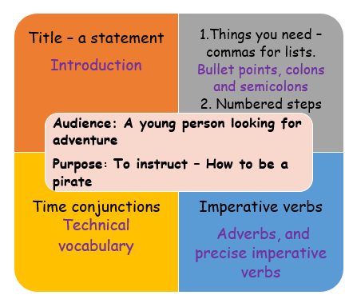
Pirate Handbook: English Threshold Concepts
Spirituality: Can following instructions help us to flourish?
Instructional Writing
Reading
Read fluently
Identify the meaning of words in context
Extract information and ideas from a text
Make inferences supported by evidence
Identify writers’ techniques - Instructions
Title – describing the aim
A list of things you need
Sub-headings
Numbered steps
Clear diagrams
Imperative verbs
Deeper Thinking: Read Treasure Island. Explore how the characters follow instructions (or not!)

Slide 9
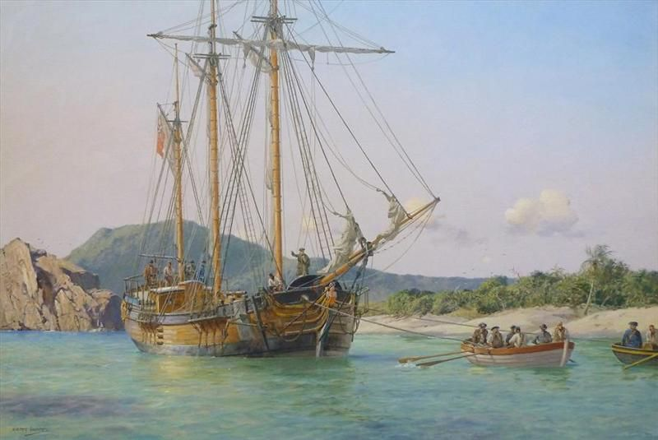
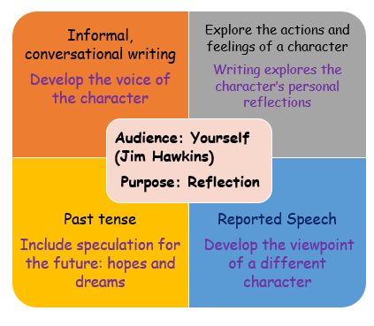
Treasure Island: English Threshold Concepts
Spirituality: Can diary writing help us in the search for inner freedom and wellbeing?
Diary Writing
Reading
Read fluently
Identify the meaning of words in context
Extract information and ideas from a text (main idea)
Make inferences supported by evidence
Identify writers’ techniques - Diaries
Personal pronoun ‘I’
Recount – past tense
Informal, conversational writing
Personal reflection
Reported speech
Salutation e.g. ‘Dear Diary’
Deeper Thinking: Read Treasure Island

Slide 10
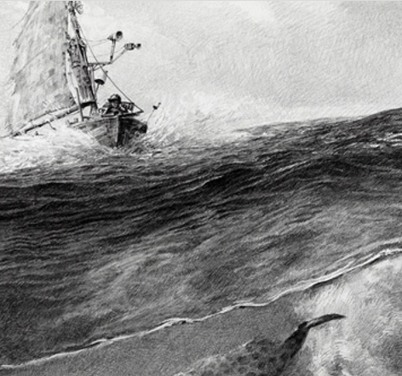
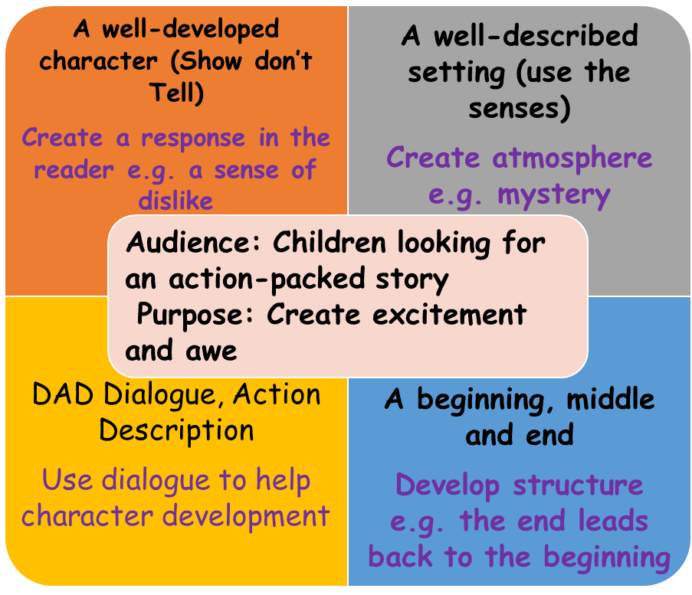
Monsters of the Sea: English Threshold Concepts
Spirituality: Can nature create a feeling of awe and wonder?
Narrative
Reading
Read fluently
Identify the meaning of words in context
Extract information and ideas from a text
Make inferences supported by evidence
Understand writers’ techniques and viewpoints
Identify writers’ techniques - Adventure
Create atmosphere using the senses
Short sentences
Ellipses
Vocabulary of uncertainty, fear, something is hidden
Simile, alliteration, onomatopoeia, metaphor
Further Vocabulary
context, inference, impression, feeling
Deeper Thinking: Read a book about nature. Does this book create a feeling of awe and wonder?

Slide 11
Progression – steps build on prior learning Grammar Grammar/Punctuation Punctuation
SOS Sentences Capital letters, full stop Apostrophes Nouns Determiners Verbs Simple Tense Pronouns Commas Adjectives Inverted Commas Reported Speech Relative Clauses Prepositions Expanded noun phrases Simple Sentences/Main clause Active Verb Form (Subject, Verb, Object) Coordinating Conjunctions Subordinating Conjunctions/ Subordinating Clause Adverbs Modal Verbs Fronted Adverbials Parenthesis Progressive Tense Semicolons Colons Hyphens Passive verb form Perfect Tense Dashes Perfect Progressive Tense
Other: Subjunctive, Sentence Patterns, Question tags
Grammar Punctuation & Spelling:
English Threshold Concepts
Teaching GPS Include daily practise: top tips, whiteboard retrieval practice, SMHW quizzes, learning bookmark and SATS-style tests. Steps to Success Step 1: Identify Step 2: Describe Step 3: Produce Step 4: Reason and Justify Step 5: Create – use in your writing. Lists of sentences each using the threshold concept. Year 5 Year 6
Embed learning into reading/writing units for introduction and retrieval practice KS3: Repeat teaching to embed learning within schemes of learning as appropriate to text type and needs of students.

