Slide 1
Threshold Concepts Year 6 The Building Blocks for Learning
Spirituality: Mirrors
Reflecting on the things greater than ourselves

Slide 2
English Threshold Concepts KS2
Writing Targets
1 | Write legibly Capital letters: I, proper nouns & sentences Full stops Question marks Join clauses using ‘and’
2 | Most sentences make sense Exclamation marks Subordinating and coordinating conjunctions
3 | Apostrophes for contracted words Commas (for lists) Paragraphs
4 | Inverted commas Correct use of tense Non-narrative: structure e.g. headings & subheadings Narrative: describe settings and characters
5 | Commas (fronted adverbials) Apostrophes for possession A range of cohesive devices: conjunctions, adverbials, pronouns & synonyms Select vocabulary: e.g. ‘Show don’t Tell’ in narratives; technical words in non-narrative Begin to match level of formality to audience
6 | Legible, cursive handwriting Semicolons, colons, hyphens, dashes, commas for clarity (relative clauses, parenthesis) Dialogue, Action, Description DAD (correctly punctuated) A range of sentence structures to match audience and purpose (incl. passive) Narrative: create atmosphere
Greater Depth | The ‘voice’ of an author Precise use of punctuation to enhance meaning Control the level of formality Non-narrative: effectively organise information and ideas Create an effect (e.g. tension)
English Threshold Concepts
Speaking
Speak clearly and confidently Communicate effectively with vocal and body language
Reading
Read for pleasure Read fluently Extract ideas and information from a text Identify the meaning of words in context Make inferences supported by evidence Understand writers’ techniques and viewpoints Understand the audience and purpose of writing
Writing
Use neat, cursive script to present with pride Use a range of punctuation to support meaning Use a range of sentence and text structures to support meaning Spell correctly to communicate clearly Use ambitious vocabulary Use subject vocabulary

Slide 3
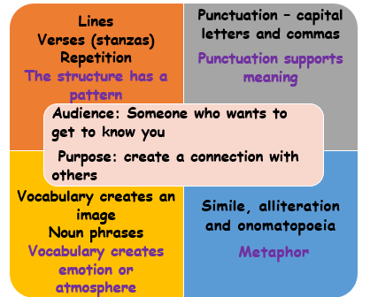
Magic Box: English Threshold Concepts
Spirituality: Can poetry help us to create a connection with others and give us a sense of belonging?
Poetry
Reading
Read fluently
Identify the meaning of words in context
Extract ideas and information from the text
Understand writers’ techniques and viewpoints
Identify writers’ techniques - Poetry
Senses: Touch, Smell, Taste, Sight, Hearing
Figurative language: Alliteration, Onomatopoeia, Repetition, Metaphor
Structure: Verse
Punctuation
Further Vocabulary
summary, imagery, expanded noun phrase, noun, determiner, adjective, preposition, phrase, main idea, annotate
Challenge: Whilst reading, can you find a connection with the characters you find out about?

Slide 4
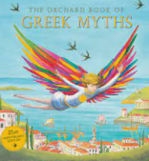
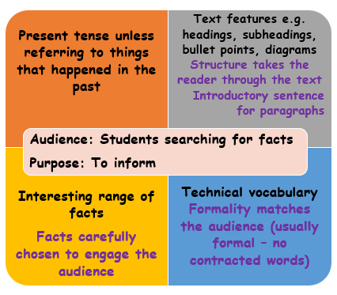
Greek Myths: English Threshold Concepts
Spirituality: Can Greek myths help us understand
the experience of living, flourishing and finding hope?
Non-chronological report
Reading
Read fluently
Identify the meaning of words in context
Extract ideas and information from a text
Can I identify writers’ techniques? Non-chronological report
Headings and sub-headings
Introduction
Sections
Introductory sentences for each paragraph
Tables, pictures, diagrams, maps etc
Technical vocabulary
Formal or informal?
Further Vocabulary
context, synonym, sequence, main idea, summary, phrase
Challenge: Read Greek Myths. Explore the messages they give.

Slide 5
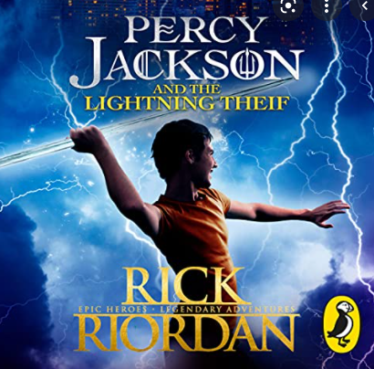
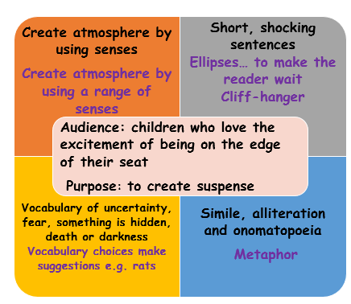
Percy Jackson and the Lightning Thief: English Threshold Concepts
Spirituality: Can stories help us find meaning and purpose in the things we value?
Narrative-Suspense
Reading
Read fluently
Identify the meaning of words in context
Understand writers’ techniques and viewpoints
Can I identify writers’ techniques? Suspense
Senses: see, hear, touch, smell, taste
Short sentences
Ellipses
Words which show fear, uncertainty, shadows, something hidden, death
Simile, metaphor
Further Vocabulary
suggest, impression, according to the text, evidence, feeling, atmosphere
Challenge: Read Percy Jackson and the Lightning Thief.
What does Percy learn about himself from his adventures?

Slide 6
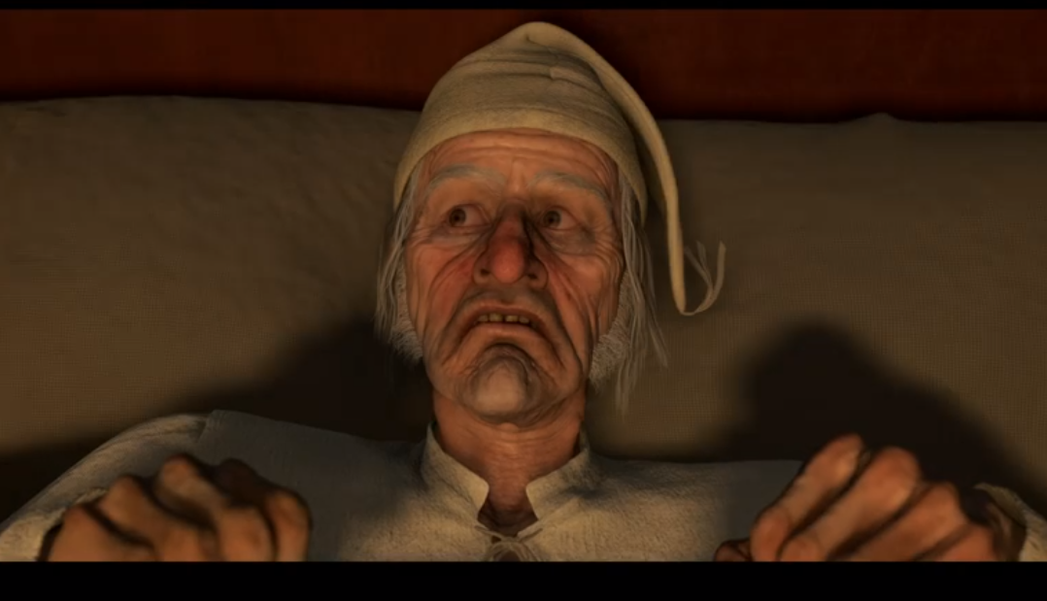
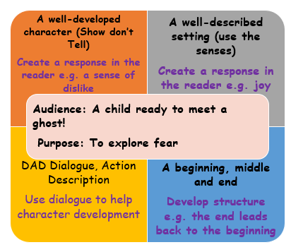
Christmas Carol: English Threshold Concepts
Spirituality: Can self reflection bring positive change?
Narrative Text
Reading
Read with fluency
Identify the meaning of words in context
Make inferences supported by evidence
Identify writers’ techniques and viewpoints
Identify writers’ techniques – Self reflection
Create atmosphere using the senses
Long sentences
Ellipses
Vocabulary of emotion
Simile, alliteration, onomatopoeia, metaphor
Further Vocabulary
impression, suggest, feeling, positive, negative, atmosphere, evidence
Challenge: Read A Christmas Carol. Explore how Scrooge changes from the start to the end of the story.

Slide 7
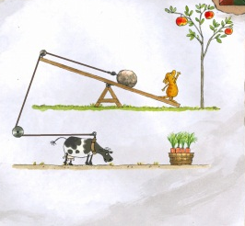
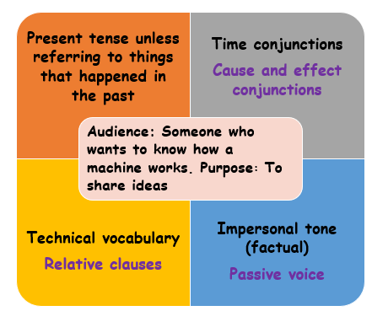
Magnificent Machines: English Threshold Concepts
Spirituality: Can human inventions create a sense of awe and wonder?
Explanation Text
Reading
Read with fluency
Identify the meaning of words in context
Extract information and ideas from a text
Identify writers’ techniques and viewpoints
Identify writers’ techniques – Explanation Texts
Clear title
Cohesive Devices
Relative clauses
Rhetorical questions
Diagrams
Further Vocabulary
Formal: no contracted words, persuasive language exaggeration
Challenge: Read a book which has a magnificent machine. What makes it magnificent?

Slide 8
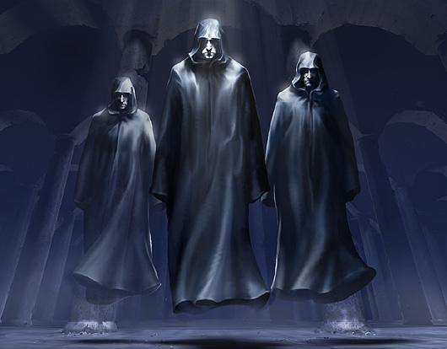
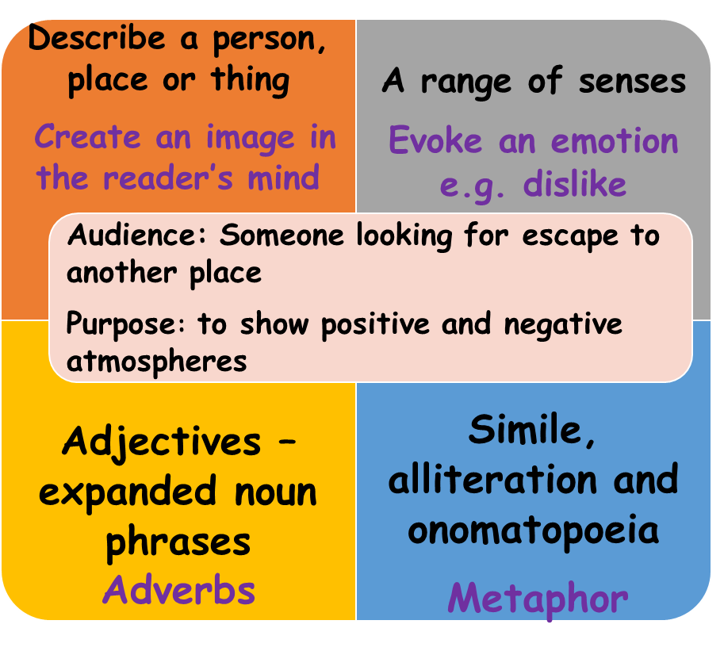
Narrative Poetry: English Threshold Concepts
Spirituality: Can classic poetry help us to experience living,
flourishing and finding hope amidst pain?
Descriptive Writing
Reading
Read fluently
Identify the meaning of words in context
Extract information and ideas from a text
Make inferences supported by evidence
Understand writers’ techniques and viewpoints
Identify writers’ techniques - Poetry
Senses: Touch, Smell, Taste, Sight, Hearing
Figurative language: Alliteration, Onomatopoeia, Repetition, Simile, Metaphor
Structure: Verse, Rhyme, alternate, couplets
Punctuation
Further Vocabulary
inference, context, feeling, impression, poetry/poem, verse, image/imagery, narrative
Challenge: Read some more narrative poems. Explore the feelings of the characters.

Slide 9
SATS prep and Writers’ Workshop
Spirituality: Can trying our best bring us inner freedom?
Writing Targets
1 | Write legibly Capital letters: I, proper nouns & sentences Full stops Question marks Join clauses using ‘and’
2 | Most sentences make sense Exclamation marks Subordinating and coordinating conjunctions
3 | Apostrophes for contracted words Commas (for lists) Paragraphs
4 | Inverted commas Correct use of tense Non-narrative: structure e.g. headings & subheadings Narrative: describe settings and characters
5 | Commas (fronted adverbials) Apostrophes for possession A range of cohesive devices: conjunctions, adverbials, pronouns & synonyms Select vocabulary: e.g. ‘Show don’t Tell’ in narratives; technical words in non-narrative Begin to match level of formality to audience
6 | Legible, cursive handwriting Semicolons, colons, hyphens, dashes, commas for clarity (relative clauses, parenthesis) Dialogue, Action, Description DAD (correctly punctuated) A range of sentence structures to match audience and purpose (incl. passive) Narrative: create atmosphere
Greater Depth | The ‘voice’ of an author Precise use of punctuation to enhance meaning Control the level of formality Non-narrative: effectively organise information and ideas Create an effect (e.g. tension)
English Threshold Concepts
Speaking
Speak clearly and confidently Communicate effectively with vocal and body language
Reading
Read for pleasure Read fluently Extract ideas and information from a text Identify the meaning of words in context Make inferences supported by evidence Understand writers’ techniques and viewpoints Understand the audience and purpose of writing
Writing
Use neat, cursive script to present with pride Use a range of punctuation to support meaning Use a range of sentence and text structures to support meaning Spell correctly to communicate clearly Use ambitious vocabulary Use subject vocabulary

Slide 10
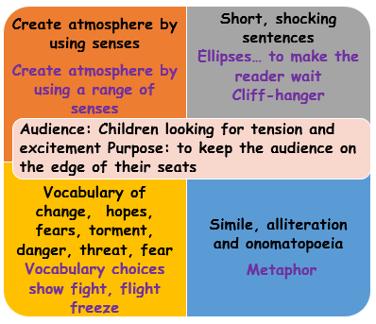
Stormbreaker - Tension: English Threshold Concepts
Spirituality: Can experiencing tension in stories help us prepare for difficult events?
Narrative - Tension
Reading
Read fluently
Identify the meaning of words in context
Extract ideas and information from the text
Understand writers’ techniques and viewpoints
Identify writers’ techniques - Tension
Senses: Touch, Smell, Taste, Sight, Hearing
Figurative language: Alliteration, Onomatopoeia, Repetition, Metaphor
Short sentences for effect
Vocabulary choice to show tension
Further Vocabulary
Hooking the reader, subject, verb, object, passive verb form (voice)
Challenge: Find further examples of tension, whilst reading Stormbreaker.

Slide 11
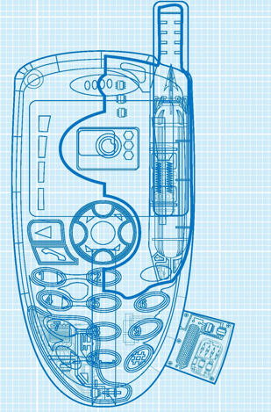
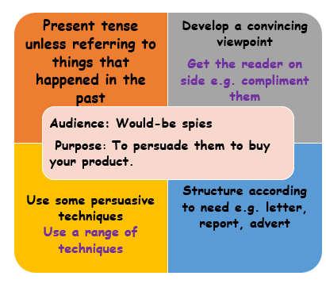
Stormbreaker – Persuasive Writing English Threshold Concepts
Spirituality: Can becoming aware of the motives of others give us peace of mind and inner freedom?
Persuasive Writing
Reading
Read fluently
Identify the meaning of words in context
Extract ideas and information from a text
Make inferences supported by evidence
Understand writers’ techniques and viewpoints
Identify writers’ techniques - Persuasion
Facts
Opinion
Repetition
Rhetorical questions
Exaggeration
Further Vocabulary
Semicolon, colon, bullet points
Challenge: Whilst reading Stormbreaker, can you spot examples of characters hiding their motives?

Slide 12
Stormbreaker Villains: English Threshold Concepts
Spirituality: Can characters in fiction help us to understand relationships?
Descriptive Writing
Audience: Teenagers looking for adventure Purpose: To explore how a character interacts with their environment
Describe a person, place or thing
Create an image in the reader’s mind
A range of senses
Evoke an emotion e.g. dislike
Adjectives – expanded noun phrases
Adverbs
Simile, alliteration and onomatopoeia
Metaphor
Reading
Read fluently
Identify the meaning of words in context
Extract information and ideas from a text
Make inferences supported by evidence
Understand writers’ techniques and viewpoints
Identify writers’ techniques - Description
Senses: Touch, Smell, Taste, Sight, Hearing
Figurative language: Alliteration, Onomatopoeia, Repetition, Simile, Metaphor
Expanded noun phrase
Further Vocabulary
protagonist, antagonist, atmosphere, compare
Challenge: Whilst reading Stormbreaker, further explore the role of the antagonist.

Slide 13
Progression – steps build on prior learning Grammar Grammar/Punctuation Punctuation
SOS Sentences Capital letters, full stop Apostrophes Nouns Determiners Verbs Simple Tense Pronouns Commas Adjectives Inverted Commas Reported Speech Relative Clauses Prepositions Expanded noun phrases Simple Sentences/Main clause Active Verb Form (Subject, Verb, Object) Coordinating Conjunctions Subordinating Conjunctions/ Subordinating Clause Adverbs Modal Verbs Fronted Adverbials Parenthesis Progressive Tense Semicolons Colons Hyphens Passive verb form Perfect Tense Dashes Perfect Progressive Tense
Other: Subjunctive, Sentence Patterns, Question tags
Grammar Punctuation & Spelling:
English Threshold Concepts
Teaching GPS Include daily practise: top tips, whiteboard retrieval practice, SMHW quizzes, learning bookmark and SATS-style tests. Steps to Success Step 1: Identify Step 2: Describe Step 3: Produce Step 4: Reason and Justify Step 5: Create – use in your writing. Lists of sentences - each sentence using the threshold concept. Year 5 Year 6
Embed learning into reading/writing units for introduction and retrieval practice KS3: Repeat teaching to embed learning within schemes of learning as appropriate to text type and needs of students.

