Slide 1
Threshold Concepts Year 7 The Building Blocks for Learning
Spirituality: Mirrors
Reflecting on the things greater than ourselves

Slide 2
English Threshold Concepts Year 7
Writing Targets
1 | Write legibly Capital letters: I, proper nouns & sentences Full stops Question marks Join clauses using ‘and’
2 | Most sentences make sense Exclamation marks Subordinating and coordinating conjunctions
3 | Apostrophes for contracted words Commas (for lists) Paragraphs
4 | Inverted commas Correct use of tense Non-narrative: structure e.g. headings & subheadings Narrative: describe settings and characters
5 | Commas (fronted adverbials) Apostrophes for possession A range of cohesive devices: conjunctions, adverbials, pronouns & synonyms Select vocabulary: e.g. ‘Show don’t Tell’ in narratives; technical words in non-narrative Begin to match level of formality to audience
6 | Legible, cursive handwriting Semicolons, colons, hyphens, dashes, commas for clarity (relative clauses, parenthesis) Dialogue, Action, Description DAD (correctly punctuated) A range of sentence structures to match audience and purpose (incl. passive) Narrative: create atmosphere
7 | Begin to use punctuation to enhance meaning Control the level of formality Non-narrative: effectively organise information and ideas Narrative: create an effect (e.g. tension)
8 | Precise use of punctuation to enhance meaning Ambitious and precise vocabulary Structure a text using a range of appropriate conventions
Greater Depth | The ‘voice’ of an author Create extended imagery (using figurative language with precision) Develop a theme
English Threshold Concepts
Speaking
Speak clearly and confidently Communicate effectively with vocal and body language
Reading
Read for pleasure Read fluently Extract ideas and information from a text Identify the meaning of words in context Make inferences supported by evidence Understand writers’ techniques and viewpoints Understand the audience and purpose of writing Use formal structures to support analysis TEA (and PEAL in the summer term) Use the analysis verbs demonstrates and suggests
Writing
Use neat, cursive script to present with pride Use a range of punctuation to support meaning Use a range of sentence and text structures to support meaning Spell correctly to communicate clearly Use ambitious vocabulary Use subject vocabulary

Slide 3
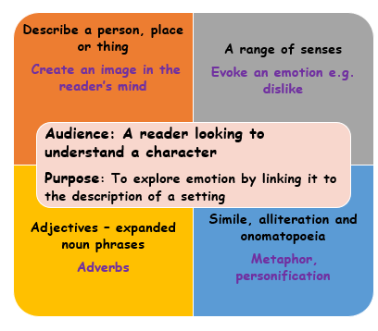
Skellig The Emotional Power of Connected Settings: English Threshold Concepts
Spirituality: Can exploring emotions lead to the search for inner freedom?
Description
Reading
Read fluently
Extract ideas and information from a text
Make inferences supported by evidence
Understand writers’ techniques and viewpoints
Use formal structures to support analysis TEA
Use analysis verbs demonstrates and suggests
Identify writers’ techniques – language choice
Sensory language
Imagery (figurative language) Alliteration Onomatopoeia Simile Metaphor Personification
Further Vocabulary
analysis, TEA, feelings, emotions, suggests, demonstrates, compare, similarities, differences, hook, negative, positive
Challenge:Whilst reading, explore how writers use settings to link with the emotions of characters.

Slide 4
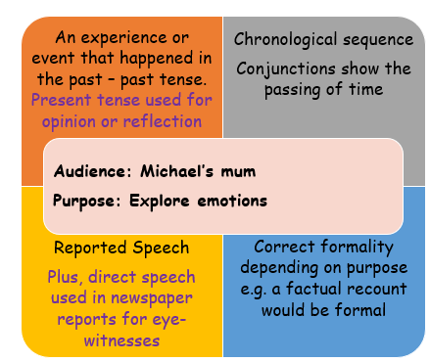
Skellig - Relationships: English Threshold Concepts
Spirituality: Can writing in role help us to explore emotions and make connects with others?
Informal Letter
Reading
Read fluently
Extract ideas and information from a text
Make inferences supported by evidence
Understand writers’ techniques and viewpoints
Use formal structures to support analysis TEA
Use analysis verbs demonstrates and suggests
Identify writers’ techniques
Short sentences
Repetition
Direct speech
Simile
Metaphor
Further Vocabulary
analysis, TEA, feelings, emotions, suggests, demonstrates, present, compare, similar, different
Challenge:Whilst reading Skellig, further explore Michael’s relationships with the characters in the novel.

Slide 5
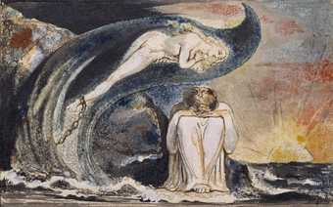
Skellig – The Poetry of William Blake: English Threshold Concepts
Spirituality: Can the natural world help us flourish?
Reading
Read fluently
Extract ideas and information from a text
Make inferences supported by evidence
Understand writers’ techniques and viewpoints
Identify writers’ techniques - Poetry
Senses: Touch, Smell, Taste, Sight, Hearing
Figurative language: Alliteration, Onomatopoeia, Repetition, Simile, Metaphor, Personification Symbolism
Structure: Verse, Rhyme, alternate, couplets
Punctuation
Further Vocabulary
rhyme scheme, negative, positive
Challenge: Explore further, how William Blake influenced David Almond’s ideas and themes in Skellig.

Slide 6
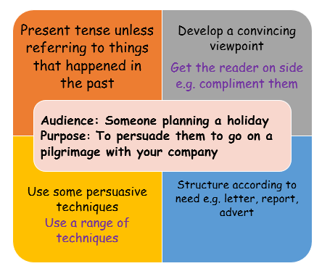
Canterbury Tales Pilgrimage: English Threshold Concepts
Spirituality: Can pilgrimage help us search for inner freedom and connect us with self, others and something beyond?
Persuasive leaflet
Reading
Read fluently
Extract ideas and information from a text
Understand writers’ techniques and viewpoints
Identify writers’ techniques - Persuasion
Facts
Opinion
Repetition
Rhetorical questions
Exaggeration
Further Vocabulary
summary, main point,
Challenge: Whilst reading, can you identify how a character’s ‘journey’ brings about change.

Slide 7
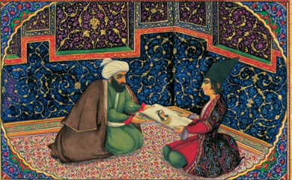
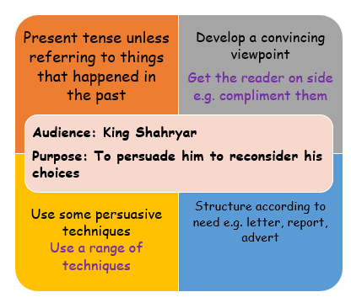
1001 Arabian Nights Shahrazad: English Threshold Concepts
Spirituality: Can writing help us to connect with others?
Speech
Reading
Read Fluently
Understand the audience and purpose of writing
Make inferences supported by evidence
Understand writers’ techniques and viewpoints
Reading Writers’ Techniques Persuasion
Content Structure
AFORREST: Alliteration, Facts, Opinion, Repetition, Rhetorical questions, Exaggeration, Statistics, Three (rule of three).
Further Vocabulary
Frame story
Challenge: Read further stories from 1001 Arabian Nights.

Slide 8
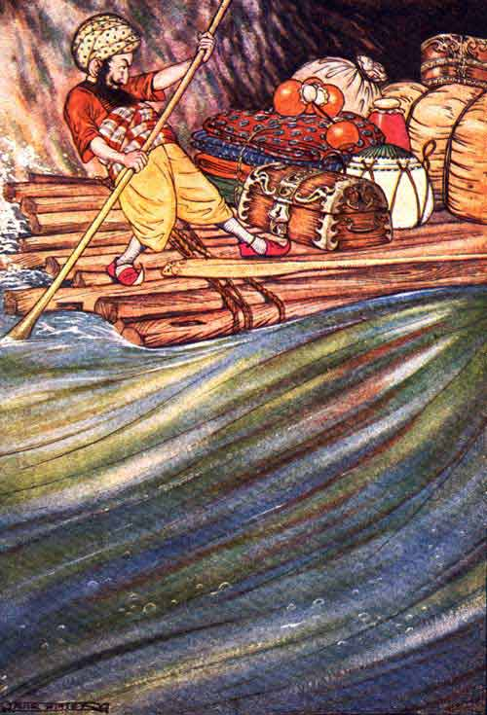
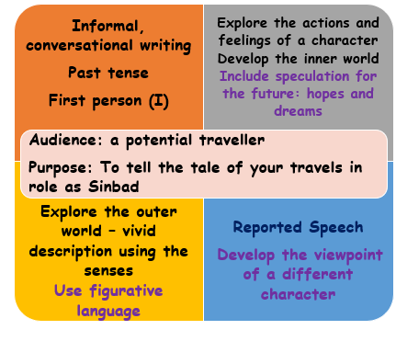
1001 Arabian Nights Sinbad: English Threshold Concepts
Spirituality: Can writing help us to connect with others?
Travelogue
Reading
Read Fluently
Understand the audience and purpose of writing
Make inferences supported by evidence
Understand writers’ techniques and viewpoints
Identify writers’ techniques - Travelogue
Personal pronoun ‘I’
Recount – past tense
Informal, conversational writing
Inner World – thoughts, feelings,reflections
Outer World – See, hear, smell, touch, taste
Further Vocabulary
Frame story
Challenge: Read further stories from 1001 Arabian Nights.

Slide 9
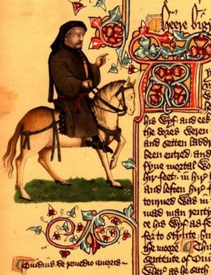
Canterbury Tales Context: English Threshold Concepts
Spirituality: Can a study of history help us to understand where we’ve come from, and where we are going to?
Reading
Understand the audience and purpose of writing
Identify the meaning of words in context
Make inferences supported by evidence
Understand writers’ techniques and viewpoints
Use formal structures to support analysis TEA
Use the analysis verbs demonstrates and suggests
Writers’ Techniques
Positive words and phrases
Further Vocabulary
Old English, Middle English, Modern English, context, prologue, phrase, positive, noun, adjective
Challenge: Read further stories from The Road to Canterbury. Explore the morals of the stories told by the pilgrims. How is the storyteller linked to the story?

Slide 10
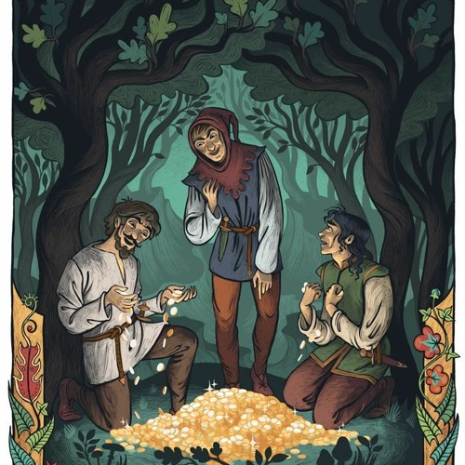
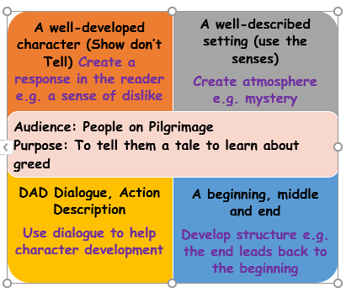
Canterbury Tales Context: English Threshold Concepts
Spirituality: Can moral tales help us to find meaning and purpose in the things we value?
Narrative – a moral tale
Reading
Read Fluently
Understand the audience and purpose of writing
Make inferences supported by evidence
Understand writers’ techniques and viewpoints
Writers’ Techniques - Moral Tale
3 main characters, someone to warn the characters, Death
Treasure, Greed and Trickery
A Storyteller – Dialogue to lead the action
The moral: the love of money is the root of all evil
Further Vocabulary
Middle English, Modern English, moral
Challenge: Read further stories from The Road to Canterbury. Explore the morals of the stories told by the pilgrims. How is the storyteller linked to the story?

Slide 11
Progression – steps build on prior learning Grammar Grammar/Punctuation Punctuation
SOS Sentences Capital letters, full stop Apostrophes Nouns Determiners Verbs Simple Tense Pronouns Commas Adjectives Inverted Commas Reported Speech Relative Clauses Prepositions Expanded noun phrases Simple Sentences/Main clause Active Verb Form (Subject, Verb, Object) Coordinating Conjunctions Subordinating Conjunctions/ Subordinating Clause Adverbs Modal Verbs Fronted Adverbials Parenthesis Progressive Tense Semicolons Colons Hyphens Passive verb form Perfect Tense Dashes Perfect Progressive Tense
Other: Subjunctive, Sentence Patterns, Question tags
Grammar Punctuation & Spelling:
English Threshold Concepts
Teaching GPS Include daily practise: top tips, whiteboard retrieval practice, SMHW quizzes, learning bookmark and SATS-style tests. Steps to Success Step 1: Identify Step 2: Describe Step 3: Produce Step 4: Reason and Justify Step 5: Create – use in your writing. Lists of sentences each using the threshold concept. Year 5 Year 6
Embed learning into reading/writing units for introduction and retrieval practice KS3: Repeat teaching to embed learning within schemes of learning as appropriate to text type and needs of students.

