Slide 1
Threshold Concepts Year 8 The Building Blocks for Learning
Spirituality: Mirrors
Reflecting on the things greater than ourselves

Slide 2
English Threshold Concepts Year 8
Writing Targets
1 | Write legibly Capital letters: I, proper nouns & sentences Full stops Question marks Join clauses using ‘and’
2 | Most sentences make sense Exclamation marks Subordinating and coordinating conjunctions
3 | Apostrophes for contracted words Commas (for lists) Paragraphs
4 | Inverted commas Correct use of tense Non-narrative: structure e.g. headings & subheadings Narrative: describe settings and characters
5 | Commas (fronted adverbials) Apostrophes for possession A range of cohesive devices: conjunctions, adverbials, pronouns & synonyms Select vocabulary: e.g. ‘Show don’t Tell’ in narratives; technical words in non-narrative Begin to match level of formality to audience
6 | Legible, cursive handwriting Semicolons, colons, hyphens, dashes, commas for clarity (relative clauses, parenthesis) Dialogue, Action, Description DAD (correctly punctuated) A range of sentence structures to match audience and purpose (incl. passive) Narrative: create atmosphere
7 | Begin to use punctuation to enhance meaning Control the level of formality Non-narrative: effectively organise information and ideas Narrative: create an effect (e.g. tension)
8 | Precise use of punctuation to enhance meaning Ambitious and precise vocabulary Structure a text using a range of appropriate conventions
Greater Depth | The ‘voice’ of an author Create extended imagery (using figurative language with precision) Develop a theme
English Threshold Concepts
Speaking
Speak clearly and confidently Communicate effectively with vocal and body language
Reading
Read for pleasure Read fluently Extract ideas and information from a text Identify the meaning of words in context Make inferences supported by evidence Understand writers’ techniques and viewpoints Understand the audience and purpose of writing Use formal structures to support detailed analysis TEA and PEAL Begin to use a range of analysis verbs Use well-chosen evidence Evidence explores ‘The Big Picture’ (theme) Sophisticated use of analysis verbs
Writing
Use neat, cursive script to present with pride Use a range of punctuation to support meaning Use a range of sentence and text structures to support meaning Spell correctly to communicate clearly Use ambitious vocabulary Use subject vocabulary

Slide 3
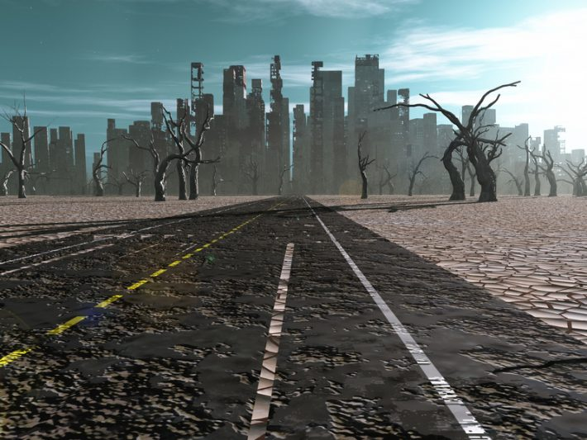
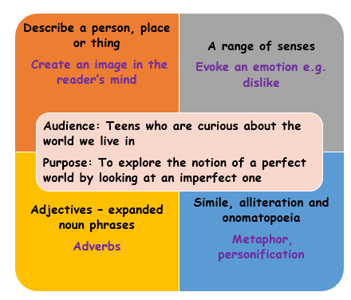
Dystopia – The Hunger Games: English Threshold Concepts
Spirituality: Can stories help us explore the idea of perfection?
Reading
Read fluently
Extract ideas and information from a text
Make inferences supported by evidence
Understand the audience and purpose of writing
Understand writers’ techniques and viewpoints
Sophisticated use of analysis verbs
Evidence explores ‘The Big Picture’ (theme)
Description
Writers’ Techniques Structure - What? Why? How?
Changing focus, flashback, flashforward, shift in perspective, zoom in/out, repetition, cyclical, foreshadowing
Dystopian Conventions
#1 Governmental control
#2 Technological control
#3 Environmental destruction
#4 Loss of individualism
#5 Survival
Challenge: Read and explore dystopian novels beyond The Hunger Games.

Slide 4
Hunger Games Learning Journey 2 under construction

Slide 5
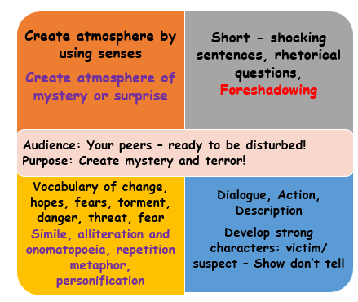
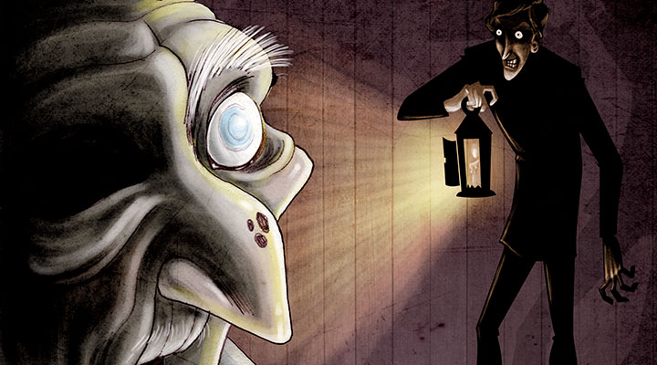
Mystery and Terror: English Threshold Concepts
Spirituality: Can stories help us to connect with others?
Narrative creating Mystery and Terror
Reading
Read fluently
Extract ideas and information from a text
Make inferences supported by evidence
Understand the audience and purpose of writing
Understand writers’ techniques and viewpoints
Sophisticated use of analysis verbs
Evidence explores ‘The Big Picture’ (theme)
Writers’ Techniques and Effects Creating Mystery and Terror
Gothic conventions: character
Gothic conventions: setting – atmosphere (sensory description)
DAD: Dialogue, Action, Description
Foreshadowing, Repetition, Short Simple Sentences
Mystery, Terror, Tension
Further Vocabulary
Nineteenth Century, Gothic, antagonist, protagonist
Challenge: Read Mystery Stories of the Nineteenth Century

Slide 6
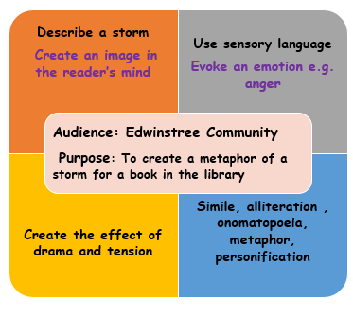
The Tempest - Storms: English Threshold Concepts
Spirituality: Can exploring emotions lead to the search for inner freedom?
Description
Reading
Read fluently
Extract information and ideas
Make inferences supported by evidence
Understand writers’ techniques and viewpoints
Identify writers’ techniques – language choice
Sensory language
Imagery (figurative language) Alliteration Onomatopoeia Simile Metaphor Personification Pathetic fallacy
Further Vocabulary
compare, similarities, differences, context, summary
Challenge:Whilst reading, explore how writers use weather to link with the emotions of characters.

Slide 7
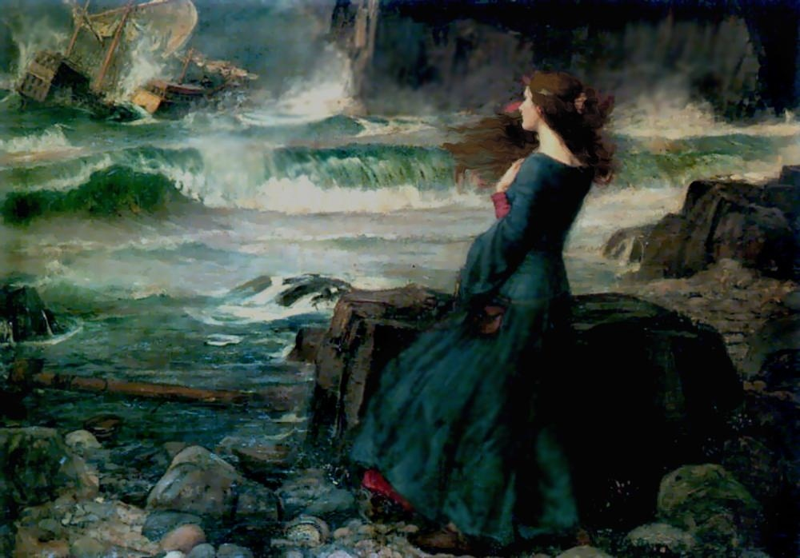
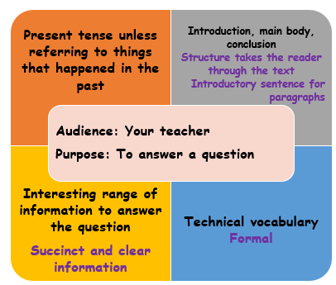
The Tempest: English Threshold Concepts
Spirituality: Can where we live shape our relationships with self, others and something beyond?
Essay
Reading
Read fluently
Extract information and ideas
Make inferences supported by evidence
Understand writers’ techniques and viewpoints
Writers’ techniques - vocabulary
Identify word class
Identify positive or negative connotations
Identify what the sentence suggests
Identify imagery (use of figurative language)
Prose or verse?
Further Vocabulary
positive, negative, neutral, summary, main point, compare, similarities, differences, iambic pentameter
Challenge: Read and explore various versions of The Tempest and other stories set on islands

Slide 8
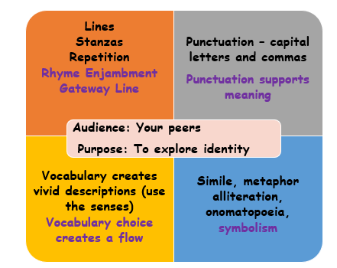
Somebody Give This Heart a Pen & Author Study: English Threshold Concepts
Spirituality: Can poetry help us get closer to ourselves and connect with others?
Spoken Word Poetry
Reading
Read fluently
Extract ideas and information from a text
Understand the audience and purpose of writing
Understand writers’ techniques and viewpoints
Evidence explores ‘The Big Picture’ (theme)
Identify writers’ techniques - Poetry
Senses: Touch, Smell, Taste, Sight, Hearing
Figurative language: Alliteration, Onomatopoeia, Repetition, Simile, Metaphor, Personification Symbolism
Structure: Verse, Rhyme, Enjambment Gateway line
Punctuation
Further Vocabulary
compare, similar, different, spoken word poetry
Challenge: Read and listen to a range Sophia Thakur’s poetry to explore the theme of identity

Slide 9
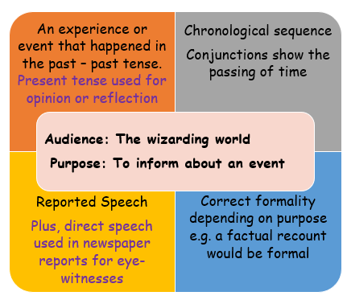
Heroes: English Threshold Concepts
Spirituality: Can our heroes give us strength and hope?
Newspaper Report
Reading
Read fluently
Extract ideas and information from a text
Make inferences supported by evidence
Understand the audience and purpose of writing
Understand writers’ techniques and viewpoints
Sophisticated use of analysis verbs
Evidence explores ‘The Big Picture’ (theme)
Techniques: Newspaper Reports
caption/photograph | Headline -alliteration/pun
5Ws: Who? What? Where? Why? When?
body | quote -direct speech
lead | reported speech
The inverted pyramid
Further Vocabulary
Archetype: romantic, classical, tragic, epic, everyman, superhero, anti-hero
Challenge: Read a book which explores heroic deeds either real or fictional.

Slide 10
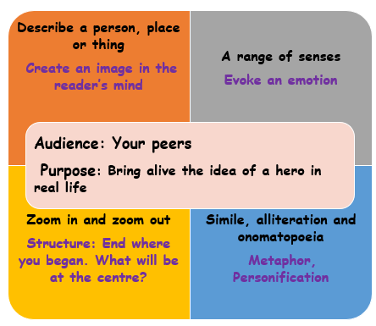
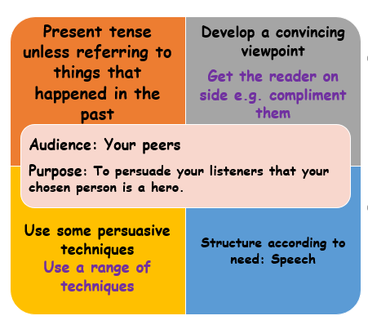
Heroes: English Threshold Concepts
Spirituality: Can our heroes give us strength and hope?
Description Speech
Reading
Read fluently
Extract ideas and information from a text
Make inferences supported by evidence
Understand the audience and purpose of writing
Understand writers’ techniques and viewpoints
Sophisticated use of analysis verbs
Evidence explores ‘The Big Picture’ (theme)
Further Vocabulary
Archetype: romantic, classical, tragic, epic, everyman, superhero, anti-hero AFORREST: Alliteration, Facts, Opinion, Repetition, Rhetorical questions, Exaggeration, Statistics, Three (rule of three). Content, Structure, Delivery
Challenge: Read a book which explores heroic deeds either real or fictional.

Slide 11
Progression – steps build on prior learning Grammar Grammar/Punctuation Punctuation
SOS Sentences Capital letters, full stop Apostrophes Nouns Determiners Verbs Simple Tense Pronouns Commas Adjectives Inverted Commas Reported Speech Relative Clauses Prepositions Expanded noun phrases Simple Sentences/Main clause Active Verb Form (Subject, Verb, Object) Coordinating Conjunctions Subordinating Conjunctions/ Subordinating Clause Adverbs Modal Verbs Fronted Adverbials Parenthesis Progressive Tense Semicolons Colons Hyphens Passive verb form Perfect Tense Dashes Perfect Progressive Tense
Other: Subjunctive, Sentence Patterns, Question tags
Grammar Punctuation & Spelling:
English Threshold Concepts
Teaching GPS Include daily practise: top tips, whiteboard retrieval practice, SMHW quizzes, learning bookmark and SATS-style tests. Steps to Success Step 1: Identify Step 2: Describe Step 3: Produce Step 4: Reason and Justify Step 5: Create – use in your writing. Lists of sentences each using the threshold concept. Year 5 Year 6
Embed learning into reading/writing units for introduction and retrieval practice KS3: Repeat teaching to embed learning within schemes of learning as appropriate to text type and needs of students.

